Slide 1

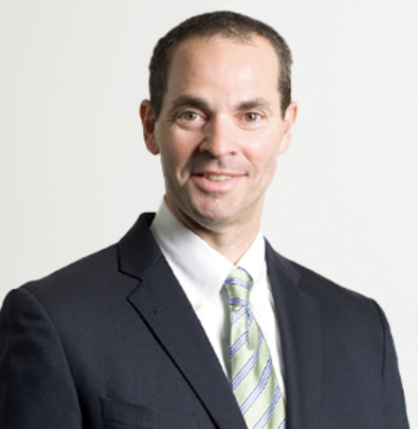
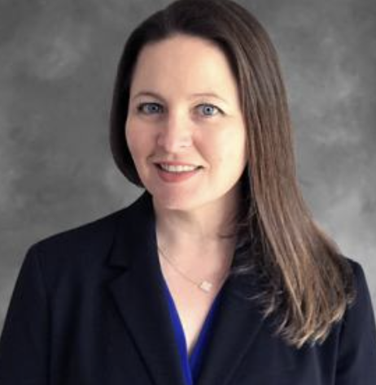
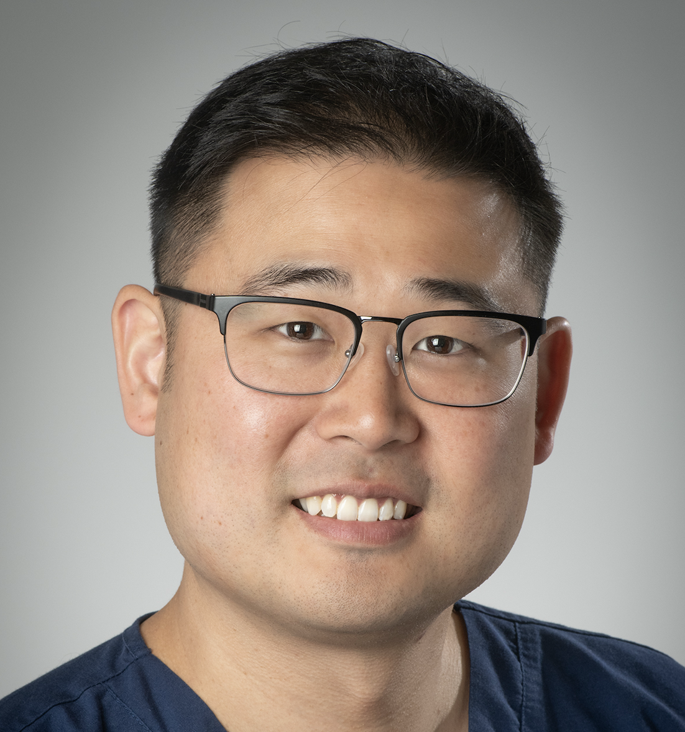
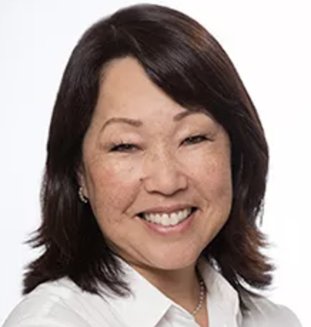

Pediatric Hand Study Group Annual Meeting 2026
Where: Atlanta, GA
When: April 24 – 25, 2026
Abstracts due January 18th, 2026
Featuring content and breakout sessions for surgeons and hand therapists
Founder’s Lecture by Dr. Ann Van Heest
Host:
Allen Peljovich
Co-Chair: Margaret Cooke
Co-Chair: Eugene Park
Co-Chair: Jennifer Chan

